Slide 1

Evaluating Data Concerning Airline Passenger Satisfaction
Parv Bhargava,
Jehan Bugli,
Venkata Madisetty,
Namratha Prakash

Slide 2





Introduction (1/4)
Key EDA steps:
Dataset: a survey of passengers on commercial airlines
Goal: predict satisfaction for passengers based on certain characteristics and aspects of the flight experience
Strategy: conduct exploratory data analysis (EDA) to evaluate potential model inputs and investigate potential models

Slide 3
Introduction (2/4)
Research (SMART) questions:
To what extent do certain surveyed passenger characteristics and flight experience components impact the likelihood that a passenger will be satisfied – rather than neutral or dissatisfied – with their trip?
How can we model the likelihood of passenger satisfaction using surveyed passenger characteristics and flight experience components in a manner that minimizes predictive bias?
To what extent can we predict the likelihood that a flight passenger will be satisfied with their experience using multiple different variable levels?

Slide 4
Introduction (3/4)
Key EDA steps:
Our dataset includes:
Continuous variables
Categorical variables
Ordinal variables (individual ratings)
Data pre-processing
Mapping distributions
Multicollinearity testing

Slide 5
Introduction (4/4)
Ratings Group 1: Pre-Flight & Wi-Fi
In-Flight Wifi Service
Departure / Arrival Time
Ease of Online Booking
Gate Location
Online Boarding
Ratings Group 2: In-Flight & Baggage
Food and Drink
Seat Comfort
In-Flight Entertainment
Onboard Service
Leg Room Service
Baggage Handling
Check-In Service
In-Flight Service
Cleanliness

Slide 6
Linear Model (1/2)
Variable | T-test P-Values (Robust SE) | Included in v2?
Gender | 0.86 | N
Customer.Type | < 2e-16 | Y
Age | 0.023 | Y
Type.of.Travel | < 2e-16 | Y
Class | < 2e-16 | Y
Flight.Distance | 9.8e-07 | Y
Pre_Flight_and_WiFi_Ratings | < 2e-16 | Y
In_Flight_and_Baggage_Ratings | < 2e-16 | Y
Arrival.Delay.in.Minutes | < 2e-16 | Y
Satisfaction—as a categorical/binary variable—runs into a fundamental interpretation issue under a standard linear model
Despite this restriction, linear probability models remain in widespread use, particularly among social scientists

Slide 7
Linear Model (2/2)
Variable | Coefficient | VIF Score
Customer.Type | 3.57e-01 | 1.36
Type.of.Travel | 4.36e-01 | 1.78
Age | 1.72e-04 | 1.10
Class | 1.24e-01 | 1.92
Flight.Distance | 5.98e-06 | 1.35
Pre_Flight_and_WiFi_Ratings | 9.04e-02 | 1.05
In_Flight_and_Baggage_Ratings | 2.28e-01 | 1.14
Arrival.Delay.in.Minutes | -4.61e-04 | 1.00
Confusion Matrix (v2 Model)
 | 0 | 1
0 | 11,934 | 1,656
1 | 1,557 | 8,716
Accuracy: 0.865

Slide 8

Logistic regression (1/4)
variable | P values
Age | 2e-16
Type.of.Travel | 2e-16
Class | 2e-16
Inflight.wifi.service | 2e-16
Ease.of.Online.booking | 1.9e-05
Online.boarding | 2e-16
Seat.comfort | 0.024
Inflight.entertainment | 2e-16
Variable | P values
Leg.room.service | 2e-16
Baggage.handling | 1.1e-05
Checkin.service | 2e-16
Inflight.service | 0.159
Cleanliness | 2e-16
Arrival.Delay.in.Minutes | 2e-16

Slide 9

Logistic regression (2/4)
Variable | VIF Score
Age | 1.06
Type.of.Travel | 1.42
Class | 1.47
Inflight.wifi.service | 1.85
Ease.of.Online.booking | 1.68
Online.boarding | 1.27
Seat.comfort | 1.85
Inflight.entertainment | 2.41
Variable | VIF Score
Leg.room.service | 1.18
Baggage.handling | 1.71
Checkin.service | 1.16
Inflight.service | 1.87
Cleanliness | 2.02
Arrival.Delay.in.Minutes | 1.02

Slide 10


Logistic regression (3/4)
Accuracy | 0.879
Precision | 0.859
Recall | 0.86
F measure | 0.86
Specificity | 0.894
AUC | 0.948
Confusion Mattrix
 | 0 | 1
0 | 12151 | 1439
1 | 1445 | 8828

Slide 11
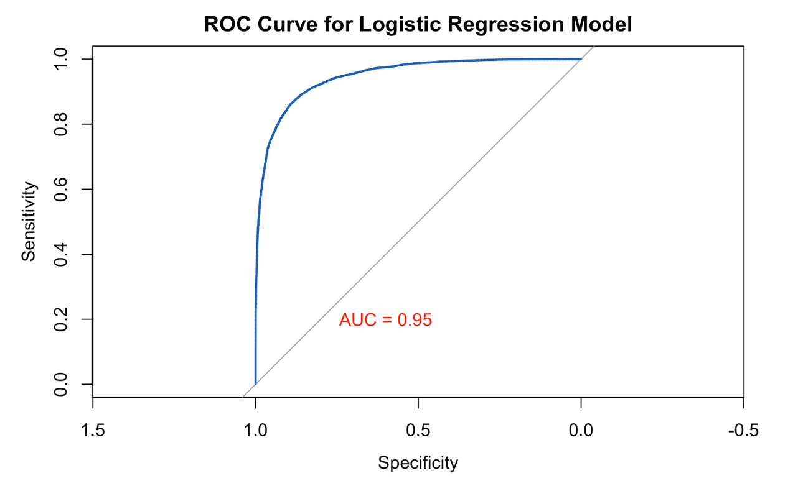
Logistic regression (4/4)
ROC Curve

Slide 12
Decision Tree (1/5)
Data Preparation
Decision Tree Model Building
Model Tuning and Evaluation
Model Performance Analysis

Slide 13
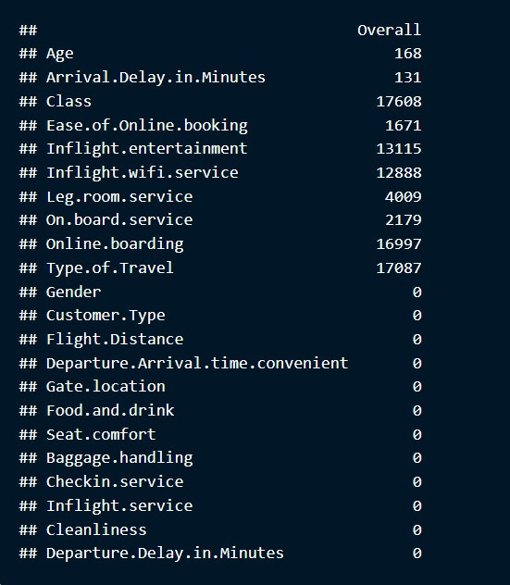
Decision Tree (2/5)
The class of travel and type of travel are the most influential factors in determining passenger satisfaction, indicating the importance of service level and travel purpose.
Online and inflight services (boarding, entertainment, wifi) are also crucial, emphasizing the importance of digital experience and onboard comfort.
Personal factors like Age have some influence but are overshadowed by service and experience-related factors.
Several variables have no discernible impact on satisfaction in this model, suggesting that they might not be critical in the context of this specific dataset or the way the model was constructed.

Slide 14
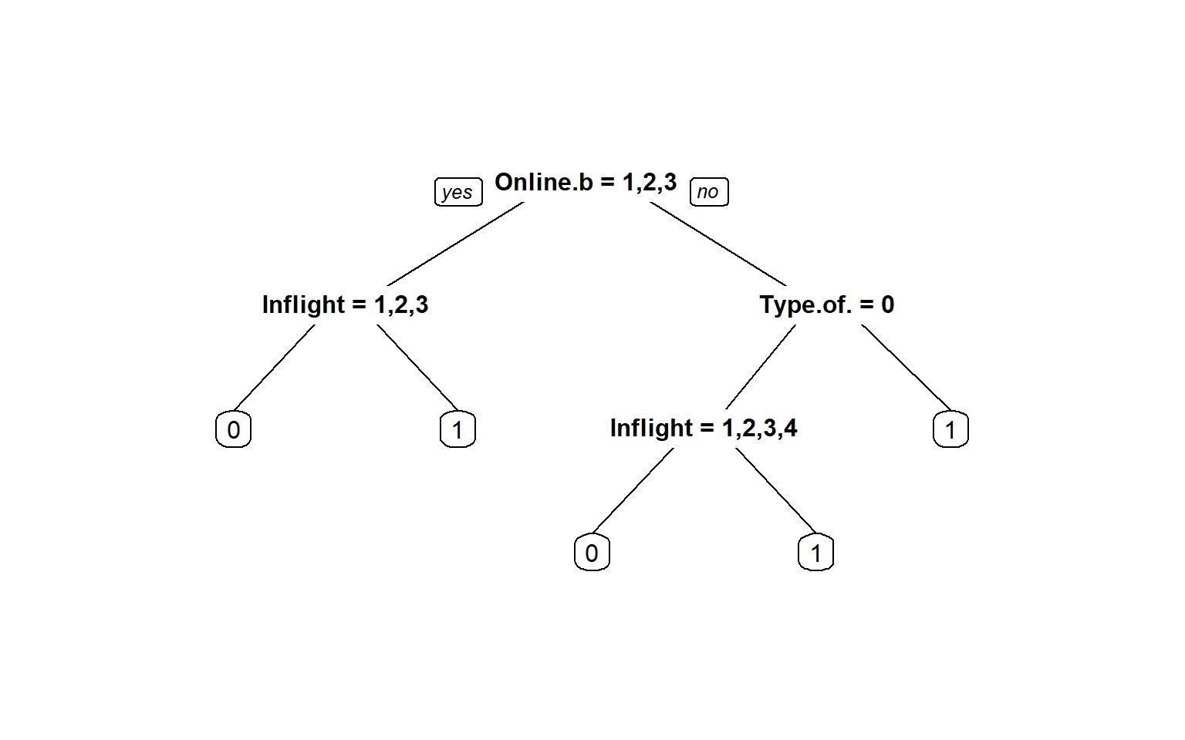
Decision Tree (3/5)
Online Boarding is a significant determinant of initial satisfaction. A better online boarding experience leads directly to a higher chance of satisfaction, bypassing other factors
Inflight Entertainment is the second most crucial factor; however, its impact is nuanced by the previous experience with online boarding.
Type of Travel being personal indicates a more significant expectation or reliance on Inflight Entertainment for satisfaction.

Slide 15
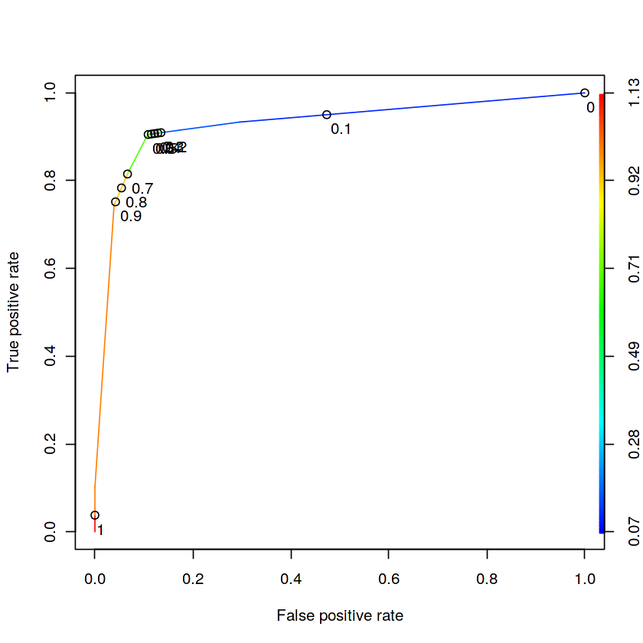
Decision Tree (4/5)
Based on the curve, an optimal threshold would likely be where the TPR is high while the FPR is still low. In this curve, a threshold around 0.1 to 0.2 might be a good balance, providing a high TPR with an acceptable FPR.

Slide 16
Decision Tree (5/5)
Confusion Matrix
The high accuracy (0.86) indicates that the model performs well overall in classifying both classes.
Precision (0.93) is also high, which suggests that when the model predicts an instance to be in the positive class, it is likely to be correct.
A good recall (0.74) value indicates that the model is able to identify most of the actual positive instances.
Specificity being high (0.96) is a good indicator that the model is adept at identifying true negatives, which is crucial when the cost of false alarms is high.
 | 0 | 1
0 | 12139 | 1451
1 | 1720 | 8553
Accuracy: 0.86

Slide 17
Random Forest Model
Accuracy | 0.957
Precision | 0.929
Recall | 0.968
f_measure | 0.948
Specificity | 0.977
AUC | 0.953
Random Forest is an ensemble learning technique that combines multiple decision trees to make more accurate and stable predictions
Trained the model with 500 trees, considering both passenger demographics and service quality indicators.
Calculated feature importance to identify the most influential predictors.

Slide 18
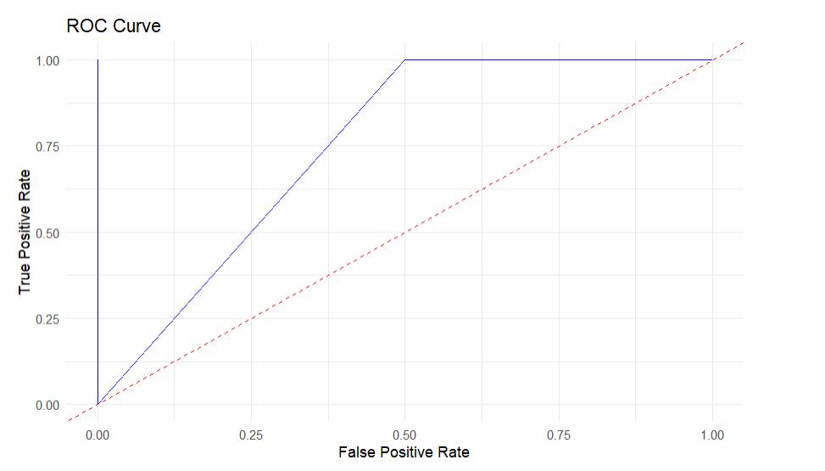
ROC Curve
The ROC curve visualizes the trade-off between the True Positive Rate (TPR) and the False Positive Rate (FPR) at various threshold settings.
AUC= 0.953

Slide 19

Conclusion
All of the models are reasonably good predictors of customer satisfaction that incorporate multiple different variable levels with limited bias
The random forest method appears to yield the best results; however, there is an interpretation tradeoff relative to other models

Slide 20

That's all for today!
See you on our next adventure!

